Slide 1

HW1b Due date September 17, 2018 11:59pm

Slide 2
CSCI 561 Foundations of Artificial Intelligence Lecture 8: Constraint Satisfaction Problems (Chapter 6)
FALL 2018
Instructor:
Prof. Sheila Tejada
cs561-l@mymaillists.usc.edu

Slide 3
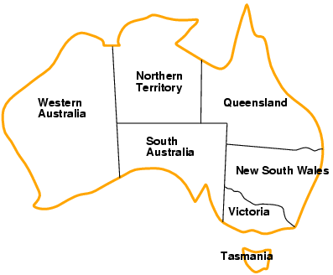
Example: map coloring problem
Variables: WA, NT, Q, NSW, V, SA, T
Domains: D_{i} = {red, green, blue} (one for each variable)
Constraints: C_{i} = <scope, rel > where scope is a tuple of variables and rel is the relation over the values of these variables
E.g., here, adjacent regions must have different colors e.g., WA ≠ NT, or (WA,NT) in {(red,green), (red,blue), (green,red), (green,blue), (blue,red), (blue,green)}

Slide 4
Example: map coloring problem
Assignment: values are given to some or all variables
Consistent (legal) assignment: assigned values do not violate any constraint
Complete assignment: every variable is assigned
Solution to a CSP: a consistent and complete assignment

Slide 5
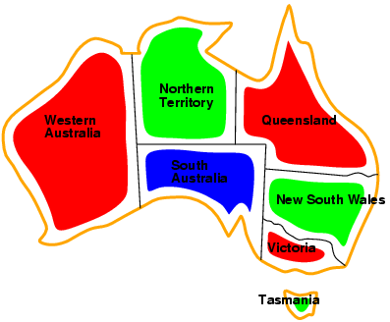
Example: map coloring problem
Solutions are complete and consistent assignments,
e.g., WA = red, NT = green, Q = red, NSW = green, V = red, SA = blue, T = green

Slide 6
So what?
What’s the big deal about CSPs?

Slide 7
Here’s what!
Many problems are naturally formulated as CSPs
Way easier to use an off-the-shelf CSP solver than build (and debug) your own representations and software
CSP solvers can be much faster than state-space searchers
Eliminate choices quickly

Slide 8
Here’s what!
CSP solvers can be much faster than state-space searchers
Eliminate choices quickly
Make SA = BLUE
Nothing touching can be blue
State space searchers would consider 3⁵ choices
With constraint propagation in CSP only consider 2⁵, an 87% reduction

Slide 9
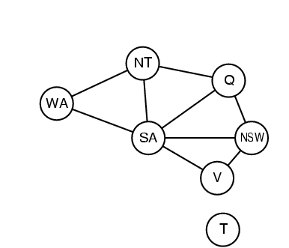
Constraint graph
Binary constraint: each constraint relates two variables
Constraint graph: nodes are variables, arcs are constraints

Slide 10
Varieties of CSPs
Discrete variables
finite domains:
n variables, domain size d → O(d^{n}) complete assignments
e.g., Boolean CSPs, incl.~Boolean satisfiability (NP-complete)
infinite domains:
integers, strings, etc.
e.g., job scheduling, variables are start/end days for each job
need a constraint language, e.g., StartJob₁ + 5 ≤ StartJob₃
Continuous variables
e.g., start/end times for Hubble Space Telescope observations

Slide 11
Varieties of constraints
Unary constraints involve a single variable,
e.g., SA ≠ green
Binary constraints involve pairs of variables,
e.g., SA ≠ WA
Higher-order (sometimes called global) constraints involve 3 or more variables,
e.g. ALL_DIFFERENT(SA, WA, Q)

Slide 12
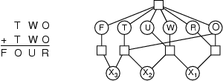
Example: cryptarithmetic
Variables: F T U W R O X₁ X₂ X₃
Domains: {0,1,2,3,4,5,6,7,8,9}
Constraints: Alldiff (F,T,U,W,R,O)
O + O = R + 10 · X₁
X₁ + W + W = U + 10 · X₂
X₂ + T + T = O + 10 · X₃
X₃ = F, T ≠ 0, F ≠ 0
Constraint hypergraph
Circles: nodes for variable
Squares: hypernodes for n-ary constraints

Slide 13
Real-world CSPs
Assignment problems
e.g., who teaches what class
Timetabling problems
e.g., which class is offered when and where?
Transportation scheduling
Factory scheduling
Many real-world problems involve real-valued variables

Slide 14
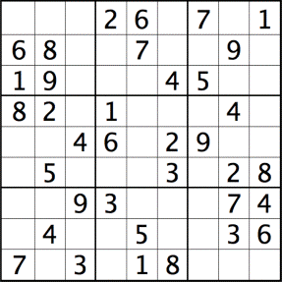
Example: sudoku
?
Variables: each square (81 variables)
Domains: [1 .. 9]
Constraints: each column, each row, and each of the nine 3×3 sub-grids that compose the grid contain all of the digits from 1 to 9

Slide 15
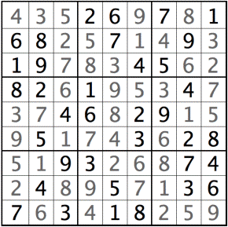
Example: sudoku
Variables: each square (81 variables)
Domains: [1 .. 9]
Constraints: each column, each row, and each of the nine 3×3 sub-grids that compose the grid contain all of the digits from 1 to 9

Slide 16
Formulation as a search problem
Let's start with the straightforward approach, then fix it
States are defined by the values assigned so far
Initial state: the empty assignment { }
Successor function: assign a value to an unassigned variable that does not conflict with current assignment
→ fail if no legal assignments
Goal test: the current assignment is complete
This is the same for all CSPs
Every solution appears at depth n with n variables → use depth-first search
Path is irrelevant, so can be discarded
b = (n - l )d at depth l, hence n! · d^{n} leaves

Slide 17
Backtracking search
Variable assignments are commutative, i.e.,
[ WA = red then NT = green ] same as [ NT = green then WA = red ]
Only need to consider assignments to a single variable at each node
→ b = d and there are d^{n} leaves
Depth-first search for CSPs with single-variable assignments is called backtracking search
Backtracking search is the basic uninformed algorithm for CSPs
Can solve n-queens for n ≈ 25

Slide 18
Backtracking Search
empty assignment
1st variable
2nd variable
3rd variable
Assignment = {}

Slide 19
Backtracking Search
empty assignment
1st variable
2nd variable
3rd variable
Assignment = {(var1=v11)}

Slide 20
Backtracking Search
empty assignment
1st variable
2nd variable
3rd variable
Assignment = {(var1=v11),(var2=v21)}

Slide 21
Backtracking Search
empty assignment
1st variable
2nd variable
3rd variable
Assignment = {(var1=v11),(var2=v21),(var3=v31)}

Slide 22
Backtracking Search
empty assignment
1st variable
2nd variable
3rd variable
Assignment = {(var1=v11),(var2=v21),(var3=v32)}

Slide 23
Backtracking Search
empty assignment
1st variable
2nd variable
3rd variable
Assignment = {(var1=v11),(var2=v22)}

Slide 24
Backtracking Search
empty assignment
1st variable
2nd variable
3rd variable
Assignment = {(var1=v11),(var2=v22),(var3=v31)}

Slide 25
Improving backtracking efficiency
General-purpose methods can give huge gains in speed (like using heuristics in informed search):
Which variable should be assigned next?
In what order should its values be tried?
Can we detect inevitable failure early?

Slide 26

Most constrained variable
Most constrained variable:
choose the variable with the fewest legal values
a.k.a. minimum remaining values (MRV) heuristic

Slide 27

Most constraining variable
Tie-breaker among most constrained variables
Most constraining variable:
choose the variable with the most constraints on remaining variables

Slide 28
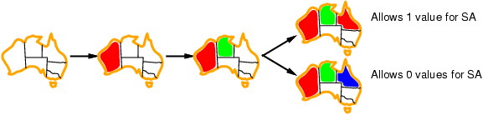
Least constraining value
Given a variable, choose the least constraining value:
the one that rules out the fewest values in the remaining variables
Combining these heuristics makes 1000 queens feasible

Slide 29
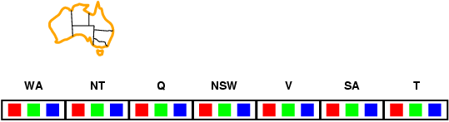
Forward checking
Idea:
Keep track of remaining legal values for unassigned variables (inference step)
Terminate search when any variable has no legal values

Slide 30
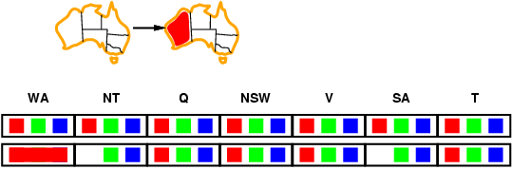
Forward checking
Idea:
Keep track of remaining legal values for unassigned variables (inference step)
Terminate search when any variable has no legal values

Slide 31
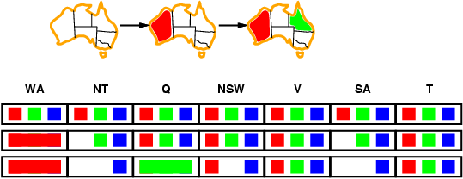
Forward checking
Idea:
Keep track of remaining legal values for unassigned variables
Terminate search when any variable has no legal values

Slide 32
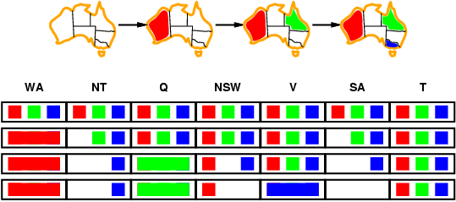
Forward checking
Idea:
Keep track of remaining legal values for unassigned variables
Terminate search when any variable has no legal values

Slide 33
Forward Checking Limitations
Forward checking propagates information from assigned to unassigned variables, but doesn't provide early detection for all failures:
NT and SA are next to each other and cannot both be blue!
Constraint propagation repeatedly enforces constraints locally

Slide 34
Node and Arc consistency
A single variable is node-consistent if all the values in its domain satisfy the variable’s unary constraints
A variable is arc-consistent if every value in its domain satisfy the binary constraints
i.e., Xi arc-consistent with Xj if for every value in Di there exists a value in Dj that satisfies the binary constraints on arc (Xi, Xj)
A network is arc-consistent if every variable is arc-consistent with every other variable.
Arc-consistency algorithms: reduce domains of some variables to achieve network arc-consistency.

Slide 35
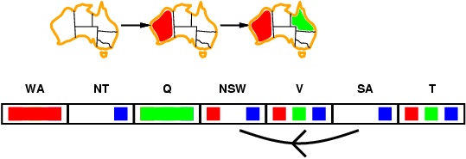
Arc consistency
Simplest form of propagation makes each arc consistent
X →Y is consistent iff
for every value x of X there is some allowed y

Slide 36
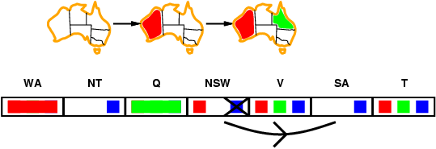
Arc consistency
Simplest form of propagation makes each arc consistent
X →Y is consistent iff
for every value x of X there is some allowed y

Slide 37
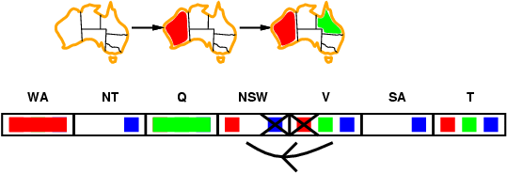
Arc consistency
Simplest form of propagation makes each arc consistent
X →Y is consistent iff
for every value x of X there is some allowed y
If X loses a value, neighbors of X need to be rechecked

Slide 38
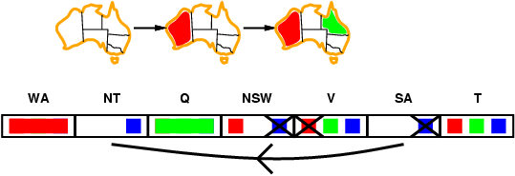
Arc consistency
Simplest form of propagation makes each arc consistent
X →Y is consistent iff
For every value x of X there is some allowed y
If X loses a value, neighbors of X need to be rechecked
Arc consistency detects failure earlier than forward checking
After running AC-3, either every arc is arc-consistent or some variable has empty domain, indicating the CSP cannot be solved.
Can be run as a preprocessor or after each assignment

Slide 39
Arc consistency algorithm AC-3
Start with a queue that contains all arcs
Pop one arc (X_{i}, X_{j}) and make X_{i} arc-consistent with respect to X_{j}
If D_{i} was not changed, continue to next arc,
Otherwise, D_{i} was revised (domain was reduced), so need to check all arcs connected to X_{i} again: add all connected arcs (X_{k}, X_{i}) to the queue. (this is because the reduction in D_{i} may yield further reductions in D_{k})
If D_{i} is revised to empty, then the CSP problem has no solution.

Slide 40
Arc consistency algorithm AC-3
Time complexity: ? (n variables, d values)

Slide 41
Arc consistency algorithm AC-3
Time complexity: O(n²d³) (n variables, d values)
(each arc can be queued only d times, n² arcs (at most), checking one arc is O(d²))

Slide 42
Backtracking search

Slide 43
Local search for CSPs
Hill-climbing, simulated annealing typically work with "complete" states, i.e., all variables assigned
To apply to CSPs:
allow states with unsatisfied constraints
operators reassign variable values
Variable selection: randomly select any conflicted variable Value selection by min-conflicts heuristic:
choose value that violates the fewest constraints
i.e., hill-climb with h(n) = total number of violated constraints

Slide 44
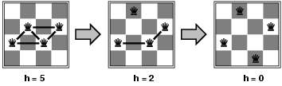
Example: 4-Queens
States: 4 queens in 4 columns (4⁴ = 256 states)
Actions: move queen in column
Goal test: no attacks
Evaluation: h(n) = number of attacks
Given random initial state, can solve n-queens in almost constant time for arbitrary n with high probability (e.g., n = 10,000,000)

Slide 45
Example: 4-Queens

Slide 46
Example: 4-Queens

Slide 47
Summary
CSPs are a special kind of problem:
states defined by values of a fixed set of variables
goal test defined by constraints on variable values
Backtracking = depth-first search with one variable assigned per node
Variable ordering and value selection heuristics help significantly
Forward checking prevents assignments that guarantee later failure
Constraint propagation (e.g., arc consistency) does additional work to constrain values and detect inconsistencies
Iterative min-conflicts is often surprisingly effective in practice

Slide 48
CSCI561 Midterm 1 is Monday Sept 24 at 8:00pm - 9:50pm
Please arrive 10 minutes early and be prepared to show your student ID.
You will be sent an email informing you of which rooms to go to.
Exam covers all material from Lectures 1-8 and chapters 1-6 (up to and including CSP).

Slide 49
The schedules of the customers are:
Company 1: Webflix: 8:00-9:00am
Company 2: Anazon: 8:30-9:30am
Company 3: Pied Piper: 9:00-10:00am
Company 4: Hooli: 9:00-10:00am
Company 5: Gulu: 9:30-10:30am
Using Company as variable, formulate this problem as a CSP problem with variables, domains, and constraints. Constraints should be specified formally and precisely, but may be implicit rather than explicit. Draw the constraint graph associated with your CSP.
The profiles of your engineers are:
Albacore can maintain Pied Piper and Hooli.
Bosam can maintain all companies, but Webflix.
Coleslaw can maintain all companies.

Slide 50
Show the domains of the variables after running arc-consistency on this initial graph (after having already enforced any unary constraints).
Give one solution to this CSP.

